Slide 1
Macroeconomics and health care
HSPM 714 J50
Fall 2013

Slide 2
When an economy implodes
Lots of unused resources
Idle labor
Idle capital
Lots of foregone goods and services
Less available to support health care
Less investment for future growth of economy

Slide 3
Health effects
Unemployment
Wasted time
Psychological
Physical
Loss of material wealth
Food, shelter

Slide 4
A money-driven economy can implode
If spenders spend less
Because they don’t want to buy
Because they want to save more
Paying off debts = flow to savings
Because they can’t get credit

Slide 5
A money-driven economy can implode
If spenders spend less
Because they don’t want to buy
BAD IDEA #0: Aren’t people always going to want to buy stuff with their money?
ANSWER: Not if they are capitalists who want to make money with money.
Examples: Apple and Google

Slide 6
A money-driven economy can implode
If spenders spend less
Because they don’t want to buy
Because they want to save more
For a rainy day, to increase their stock of savings
To pay off debts
Paying off debts = flow to savings

Slide 7
A money-driven economy can implode
If spenders spend less
Because they don’t want to buy
Because they want to save more
Because they can’t get credit, because the credit system has collapsed
Creditors’ stocks of savings are less
The moneyed are afraid to lend
Debtors are forced to repay loans (save)

Slide 8
Credit systems collapse
Unregulated banking can expand and then collapse
Euphoria of lending,
Then fear of not being repaid
Regulation can reduce swings
But, wealthy find ways to circumvent regulation

Slide 9
Once the economy has imploded, how can we expand it?
Wait for it to recover
Ease credit
Lend money at low interest
Or give money
Government spending
When private spending falls down,
Government spending stands up.

Slide 10
Limitations of credit easing
Once interest rate for government bonds reaches 0%, it can’t go lower.
Liquidity trap
Politically unaccepted alternatives
Giving money away
Retail lending by Federal Reserves

Slide 11
Government spending can be overdone
Total demand =
Consumption + Investment + Government + Exports minus imports
Excess total demand leads to price inflation
When the unemployed resources are re-employed
Spenders (buyers) compete by offering and allowing higher prices

Slide 12
Being perfect may not be possible. Being better is possible.
We do need discussion of how much government spending and credit easing is enough but not too much.
That discussion is hampered by pervasive BAD IDEAS.

Slide 13
Bad ideas/analogies (when applied to economics)
Sin and redemption
Public debt = public sin
Feigned concern about deficits and debt

Slide 14
Sin and redemption bad analogy
Obsession with causes of crash
“Cause” sought in bad behavior rather than the system’s weakness
Prolonged misery for millions atones for sins
Sinners ≠ Punished
Fix that by switching responsibility to “losers” and “moochers.”

Slide 15
So, we cut food stamps
Going hungry is bad for health
U.S. Rep. Paul Ryan: People on food stamps “don’t dream.”
And we try to cut Medicaid
Medical care can be good for you

Slide 16
What’s the appeal of this?
For the rich
For non-rich
Justification of riches
To make money from money,
High interest rates
Low inflation
Work hard for money
Resent others* who get it with less work
Want the money they do have to maintain value
Resonates with some religious teachings (but contradicts other teachings)

Slide 17
What’s the appeal of this?
For economists
Discredited theories
Wingnut welfare
$$$ think tanks
Mainstream media welfare
TV appearances
Expansionary austerity
The 90% debt/GDP cliff

Slide 18
Why business dislikes government spending to promote full employment
Devalues need to be nice to business (“confidence”)
Regulation
Taxation
Provides services that compete with business
Like health insurance
Fuller employment undermines bosses’ authority at workplace

Slide 19
Once the economy has imploded, how can we expand it?
Wait for it to recover
avoidable suffering and preventable illness
Ease credit
Done all we can short of having Fed go into retail banking
Government spending
2% excess unemployment implies 4% GDP gap, which government could fill.

Slide 20
How to finance government spending?
Taxes
Best if taxes fall on those who have money and aren’t spending it
But those people can fight that
Borrowing
Lenders will be people who aren’t spending
Federal Reserve can lend
“print money”

Slide 21
Concerned about the national debt?
The deficit scolds aren’t.
How can you tell?
They reject raising taxes.
Their real agenda is to make the public more dependent on them
By undermining government
Mirror image of their obsession with dependence of people on government

Slide 22
Taxes
Purpose: prevent inflation
Which lowers value of government’s money
Historical examples
Crusades – Spending gold ➔inflation
Caesar – Spending + taxing it back ➔ no inflation
During depression,government deficit helps
During inflation, government surplus helps

Slide 23
Bad ideas/analogies (when applied to depressions)
Sin and redemption
Public debt = public sin
Feigned concern about deficits and debt

Slide 24
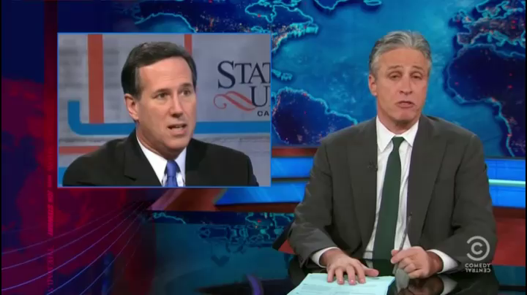
Bad idea: Free market idolatry

Slide 25
A good start for more jobs and better public health
Food stamps
Medicaid expansion under ACA
The ACA was supposed to reduce government spending slightly
Other cuts and some new taxes
The ACA with less Medicaid expansion will reduce spending
Which will shrink the economy – fewer jobs
Hospital closings

